Slide 1
SOFTWARE TESTING

Slide 2
Software testing is the process of executing a program with the aim of finding the error. To make our software perform well it should be error-free. If testing is done successfully it will remove all the errors from the software.

Slide 3
There are seven principles in software testing:
Testing shows the presence of defects
Exhaustive testing is not possible
Early testing
Defect clustering
Pesticide paradox
Testing is context-dependent
Absence of errors fallacy

Slide 4
Testing shows the presence of defects:
The goal of software testing is to make the software fail.
Software testing reduces the presence of defects.
Software testing talks about the presence of defects and doesn’t talk about the absence of defects.
Software testing can ensure that defects are present but it can not prove that software is defect-free.
Even multiple testing can never ensure that software is 100% bug-free.
Testing can reduce the number of defects but not remove all defects.

Slide 5
Exhaustive testing is not possible
It is the process of testing the functionality of the software in all possible inputs (valid or invalid) and pre-conditions is known as exhaustive testing.
Exhaustive testing is impossible means the software can never test at every test case.
It can test only some test cases and assume that the software is correct and it will produce the correct output in every test case.
If the software will test every test case then it will take more cost, effort, etc., which is impractical.

Slide 6
Early Testing
To find the defect in the software, early test activity shall be started.
The defect detected in the early phases of SDLC will be very less expensive.
For better performance of software, software testing will start at the initial phase i.e. testing will perform at the requirement analysis phase.

Slide 7
Defect clustering:
In a project, a small number of modules can contain most of the defects.
Pareto Principle to software testing state that 80% of software defect comes from 20% of modules.

Slide 8
Pesticide paradox
Repeating the same test cases, again and again, will not find new bugs.
So it is necessary to review the test cases and add or update test cases to find new bugs.

Slide 9
Testing is context-dependent
The testing approach depends on the context of the software developed. Different types of software need to perform different types of testing. For example, The testing of the e-commerce site is different from the testing of the Android application.

Slide 10
Absence of errors fallacy
If a built software is 99% bug-free but it does not follow the user requirement then it is unusable.
It is not only necessary that software is 99% bug-free but it is also mandatory to fulfill all the customer requirements.

Slide 11
Software Engineering | Testing Guidelines

Slide 12
Testing Guidelines
Development team should avoid testing the software
Software can never be 100% bug-free Start as early as possible Prioritize sections The time available is limited Testing must be done with unexpected and negative inputs
Inspecting test results properly Validating assumptions:

Slide 13
Software Testing Process
Planning
Preparation
Execution
Reporting

Slide 14
TESTING TYPES

Slide 15
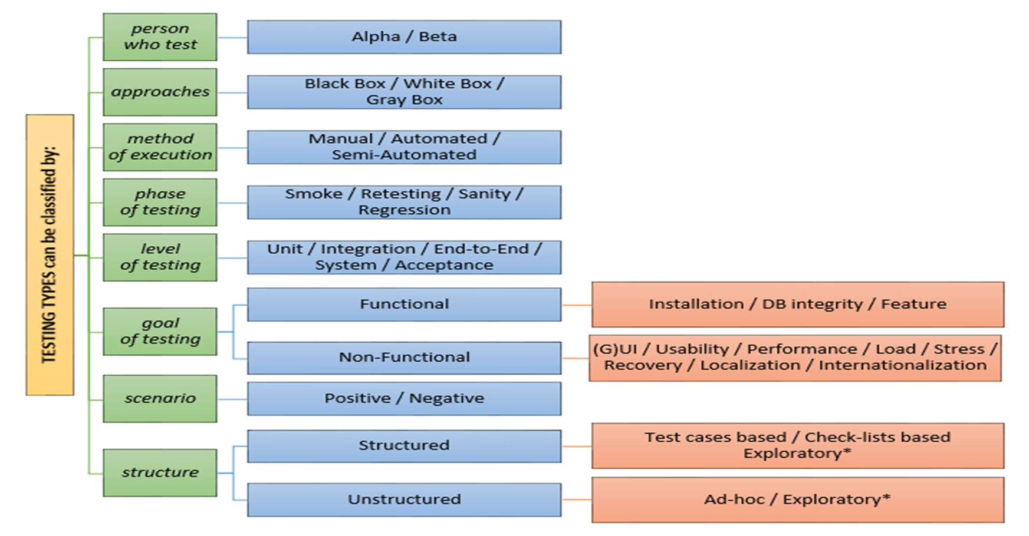

Slide 16
Unit Testing
ØTesting an individual software component or module is termed as Unit Testing.
Ø It is typically done by the programmer and not by testers, as it requires detailed knowledge of the internal program design and code.

Slide 17
Automation Testing
Automation Testing or Test Automation is a software testing technique that performs using special automated testing software tools to execute a test case suite.
•Automation testing is a Software testing technique to test and compare the actual outcome with the expected outcome.
•This can be achieved by writing test scripts or using any automation testing tool.
•Test automation is used to automate repetitive tasks and other testing tasks which are difficult to perform manually.

Slide 18
Manual Testing
•Manual testing requires physical time and effort to ensure the software code meets the requirement
•This involves checking log files, external services and the database for errors.

Slide 19
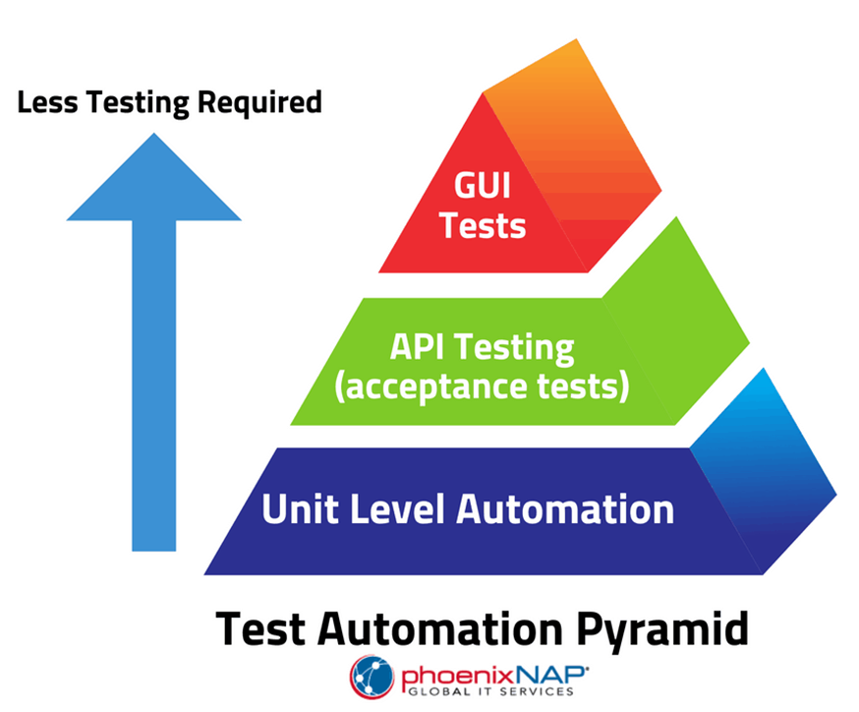
Automation Testing
The test automation performs testing at three different levels
1.Unit Level Automation
2.API Testing
3.User Interface

Slide 20
Why Automation Testing?
Test automation has many benefits for app testing cycles. Also, it is less time-consuming.
Advantage of Automation Testing:
Running Tests :
Test can be started from anywhere and anytime.
Fewer Human Resources:
Test automation engineer will write scripts to automate the tests.
Reusability:
The scripts are reusable and new scripts is not required every time

Slide 21
Bugs:
Automation helps to find bugs in the early stages of software development, reducing expenses and working hours to fix these problems as well.
Reliability:
Automated testing is more reliable and way quicker when running boring repetitive standardized tests which can not be skipped but may cause errors when manually tested.

Slide 22
Is Automated Testing Making Manual Testing Obsolete?
No Even though the automatic performance of most processes takes place in automation testing, some manual labor is still a must.
Generating the initial script for testing requires human efforts.
Also, in any automated process, human supervision is mandatory.
Automation simply makes the testing process easier.
However, it doesn’t make manual testing obsolete.
You only get the best result by combining both manual and automated tests.

Slide 23
Need for Performance Testing
Performance testing is important for the following reason,
According to Dunn & Bradstreet, 59% of Fortune 500 companies experience an estimated 1.6 hours of downtime every week
Only a 5-minute downtime of Google.com (19-Aug-13) is estimated to cost the search giant as much as $545,000.
It's estimated that companies lost sales worth $1100 per second due to a recent Amazon Web Service Outage.

